Slide 1
Nano auto Hydroponic
CMP-5045B Embedded System
Module organizer: Edwin Ren
Student: Book Wilaiwan
ID: 100415334

Slide 2
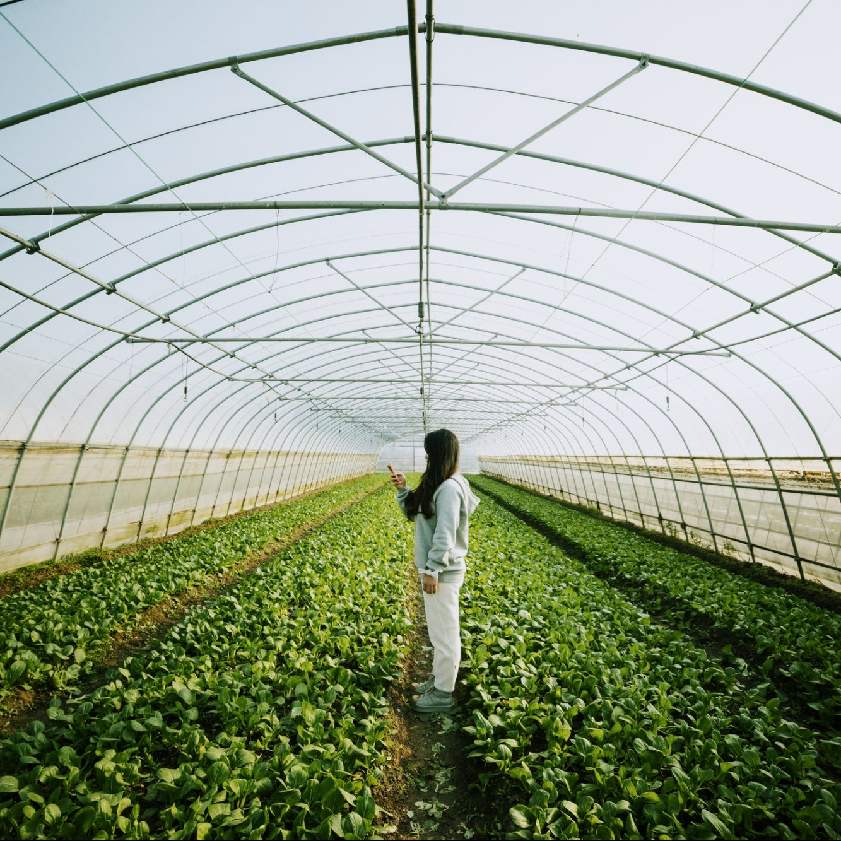
Application and purposes
Since humanity need to be able to live more sustainably more than ever before due to many factors such as overcrowding, lack of resources. This project will hopefully contribute to the effort
This project aims to make growing vegetables at home a much easier and more manageable at a low cost
Target audiences are anyone above the age of nine

Slide 3
Hardware and Software Specification
Hardware
STM32F7-DISCOVERY board, GLCD, Touch Screen,
Analogue water sensor
Digital buzzer
LED
Micro Arduino pump (3-5v) and plastic hose
Analogue button
Relay
Software
Board Support: STM32F746G-DISCOVERY (v 1.1.1)
Uvision Keli software (v5.1.8)
Driver: Touch screen (v1.1.1)
Driver: Startup (v1.2.2)
Driver STM32Cube Framework (API): Classic (v1.2.5)
Graphic LCD (API): Graphic LCD (v1.1.1)
Touch Screen (API): Touch Screen (v 1.1.1)
CMSIS: Core (5.3.0)
RTOS (API): Keli RTX (v4.82.0)
Driver STM32Cube HAL: ADC, Common, Cortex, DMA, GPIO, I2C,LTDC, PWR,RCC, SDRAM, UART

Slide 4
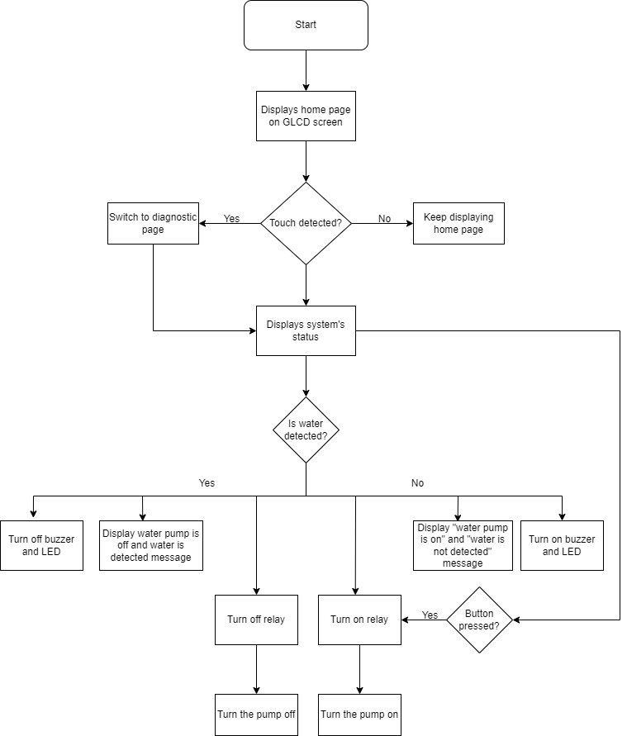
Flow Chart

Slide 5
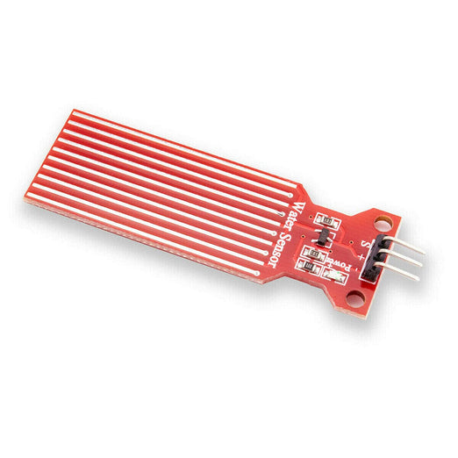
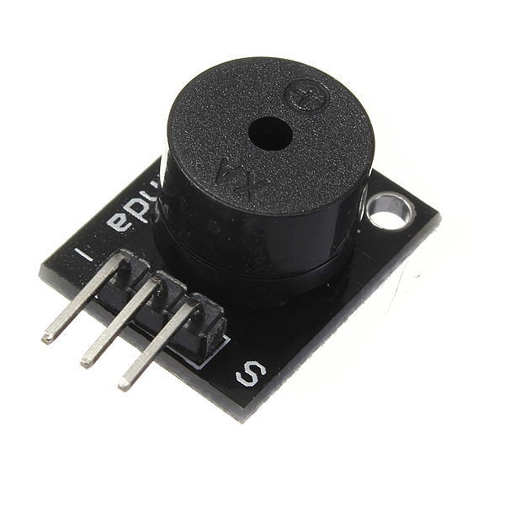
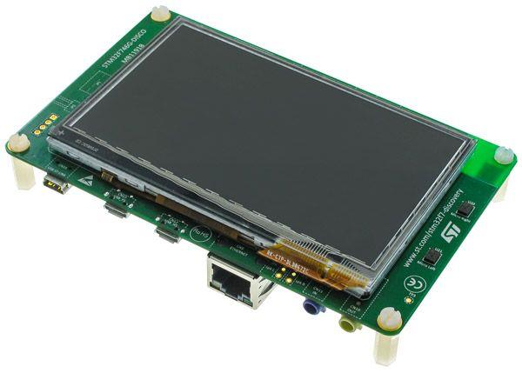
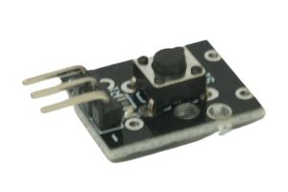
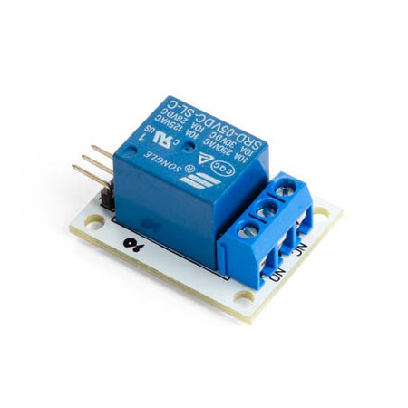
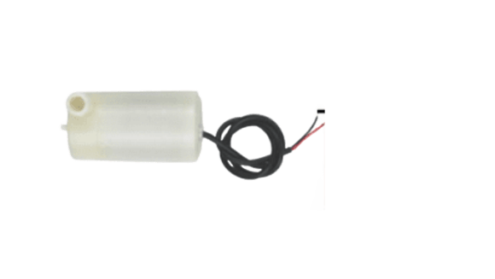
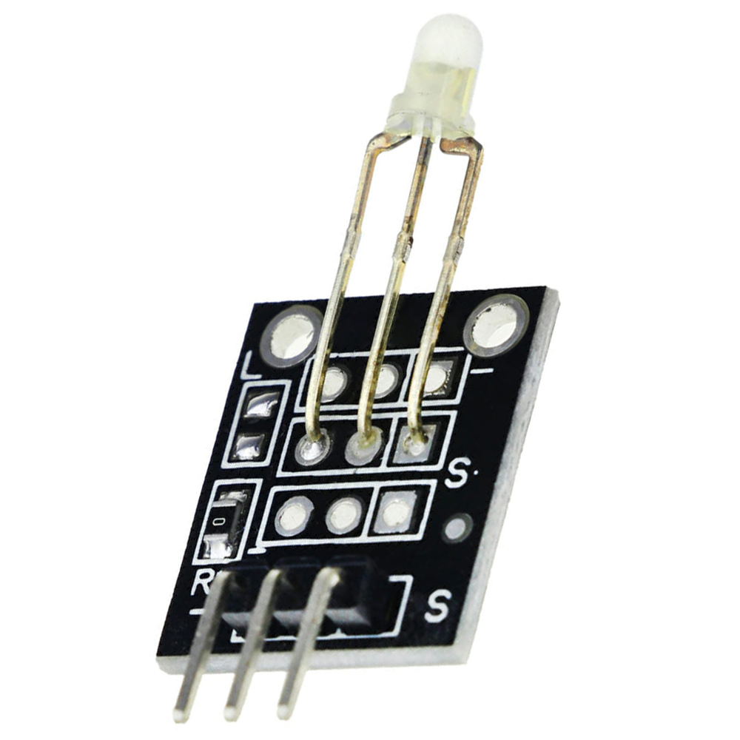
Peripherals
Water pump – pumps out water when needed
LED – help diagnose the water pump status
Relay – use to control the water pump
Button: for pressing to pour water manually
STM32F746NG and the GLCD: for running the code and the screen is used to indicate what is currently happening and to be interacted with
Buzzer: use for alerting user that water level is adequate
Water detector: inside the pipe that the plant will be place in, when the water level is adequate for the plant that alarm will be sou

Slide 6
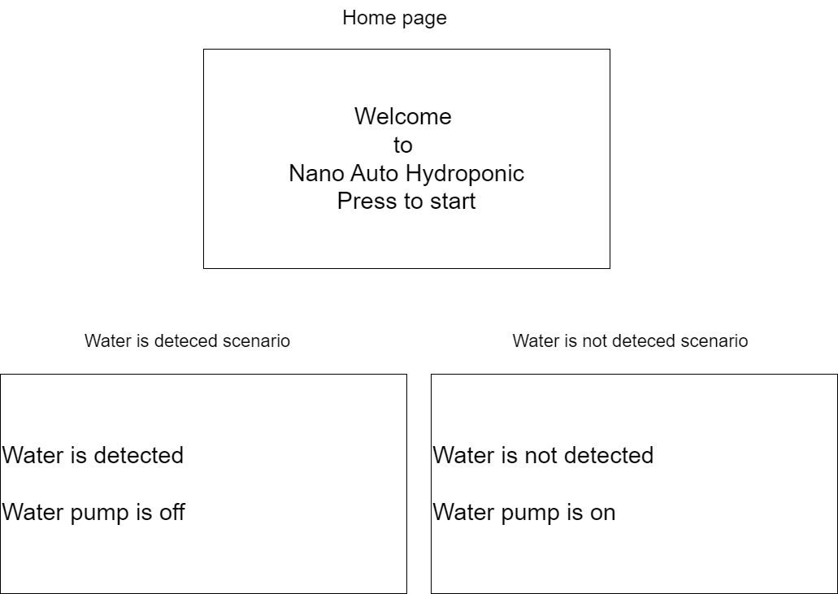
User Interface

Slide 7
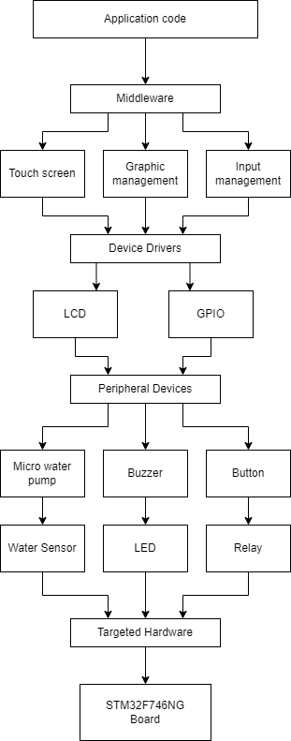
System’s Architecture

